Slide 1

Kickstart Your LeetCode Journey: A Beginner's Guide

Slide 2

What is LeetCode?
Online Platform
Skill Enhancement
Offers diverse coding challenges.
Improves algorithmic and data structure proficiency.
Interview Prep
Problem-Solving
Prepares users for technical interviews.
Builds critical thinking skills

Slide 3
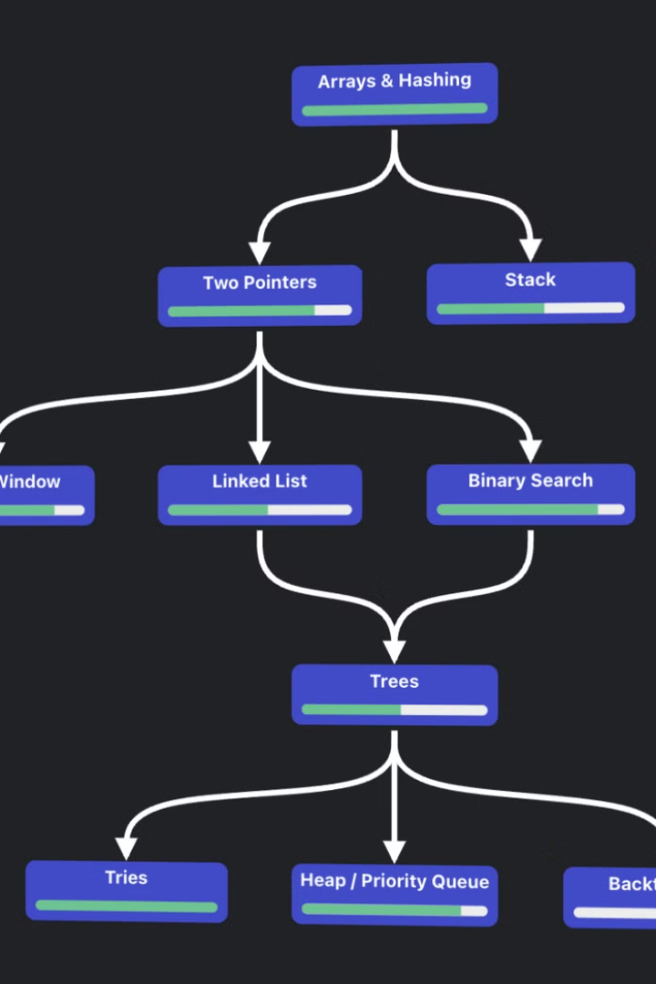
Getting Started with LeetCode
1
Create Account
Sign up and explore the platform.
2
Explore Sections
Navigate Problems, Contest, Discuss, and Explore tabs.
3
Choose Problems
Start with Arrays, Strings, and Linked Lists.
4
Select Difficulty
Begin with Easy, progress to Medium and Hard.

Slide 4
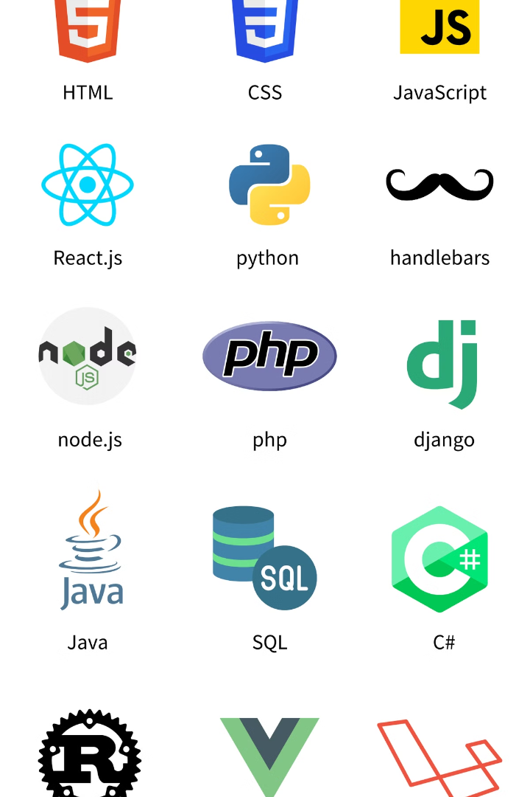



Core Programming Skills
Python
Versatile and beginner-friendly language.
Java
Object-oriented programming powerhouse.
C++
High-performance language for competitive programming.

Slide 5
Essential Data Structures
Linear Structures
Non-Linear Structures
Algorithms
Arrays
Trees
Sorting
Linked Lists
Graphs
Searching
Stacks
Queues

Slide 6

Mathematical Foundations
1
Modular Arithmetic
2
Probability
3
Combinatorics
Essential for many coding challenges.
Crucial for randomized algorithms.
Important for counting and permutation problems.

Slide 7
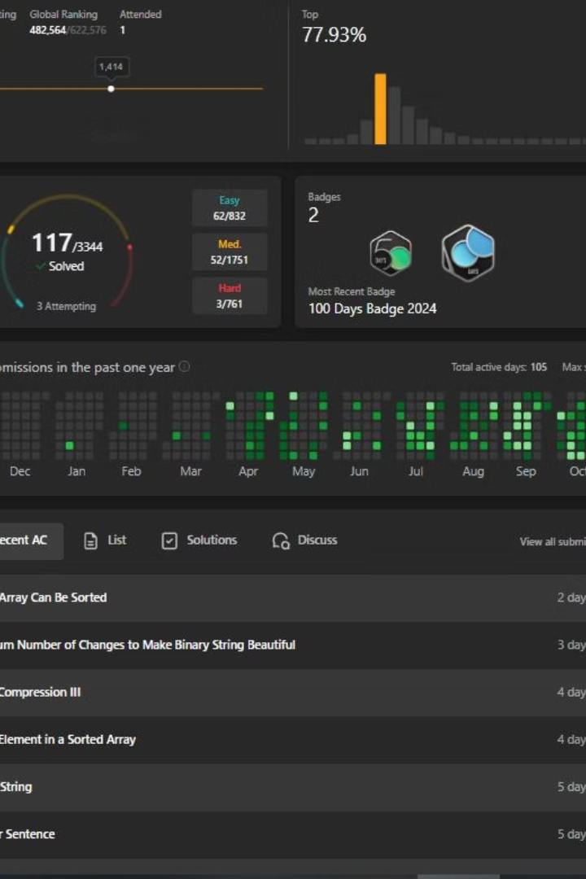




Strategies for Success
Create Study Plan
Set achievable goals and deadlines.
Practice Regularly
Solve problems consistently to build habits.
Join Contests
Participate in LeetCode competitions for growth.
Review Solutions
Learn from others' approaches and optimizations.

Slide 8
QnA

